Slide 1

Logistic Regression
Dr Bayode Ogunleye
B.Ogunleye@brighton.ac.uk

Slide 2
Learning Outcomes
  Define the concepts of logistic regression.
  Fit a binary logistic regression model using the LOGISTIC procedure.
  Describe the standard output from the LOGISTIC procedure with one continuous predictor variable.
  Read and interpret odds ratio tables and plots.

Slide 3
Overview
Type of Predictors Type of Response | Categorical | Continuous | Continuous and Categorical
Continuous | Analysis of Variance (ANOVA) | Ordinary Least Squares (OLS) Regression | Analysis of Covariance (ANCOVA)
Categorical | Contingency Table Analysis or Logistic Regression | Logistic Regression | Logistic Regression

Slide 4
Overview
Regression analysis enables you to characterize the relationship between a response variable and one or more predictor variables.
Response
Analysis
Linear
Regression
Analysis
Continuous
Logistic
Regression
Analysis
Categorical

Slide 5
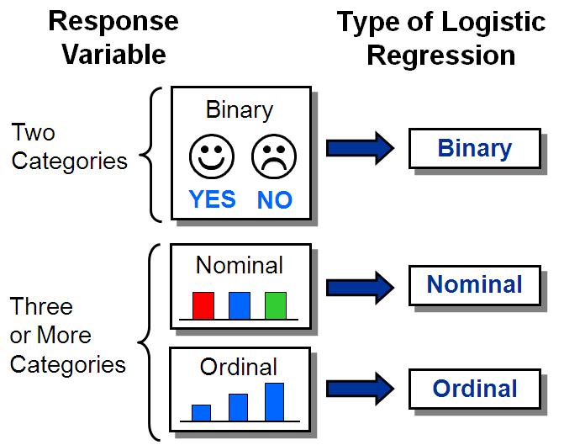
Types of Logistic Regression

Slide 6
Why Not Ordinary Least Squares Regression?
  If the response variable is categorical, then how do you code the response numerically?
  If the response is coded (1=Yes and 0=No) and your regression equation predicts 0.5 or 1.1 or -0.4, what does that mean practically?
  If there are only two (or a few) possible response levels, is it reasonable
  to assume constant variance and normality?
  OLS Regression: Y_{i}=β₀+β₁X_{1i}+ε_{i}

Slide 7
What about a Linear Probability Model?
  Probabilities are bounded, but linear functions can take on any value.
  (Once again, how do you interpret a predicted value of -0.4 or 1.1?)
  Given the bounded nature of probabilities, can you assume a linear relationship between X and p throughout the possible range of X?
  Can you assume a random error with constant variance?
  What is the observed probability for an observation?
Linear Probability Model: p_{i}=β₀+β₁X_{1i}

Slide 8
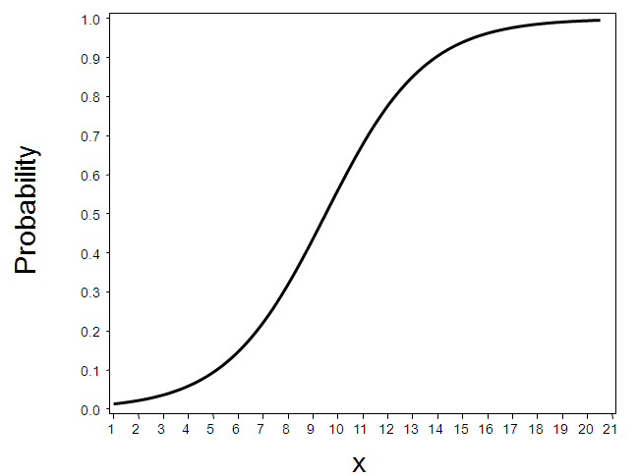
Logistic Regression Model
This plot shows a model of the relationship between a continuous predictor and the probability
of an event or outcome.
The linear model clearly does not fit if this is the true relationship between
X and the probability. In order to model this relationship directly, you must use a nonlinear function.

Slide 9
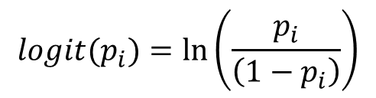
Logit Transformation
Logistic regression models transformed probabilities, called logits*,
where
i indexes all cases (observations)
p_{i} is the probability that the event (for example, a sale) occurs in the i^{th} case
ln is the natural log (to the base e).
* The logit is the natural log of the odds.
$$logit(p_{i})=ln\left(\frac{p_{i}}{\left(1−p_{i}\right)}\right)$$

Slide 10
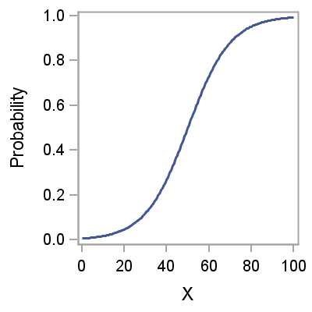
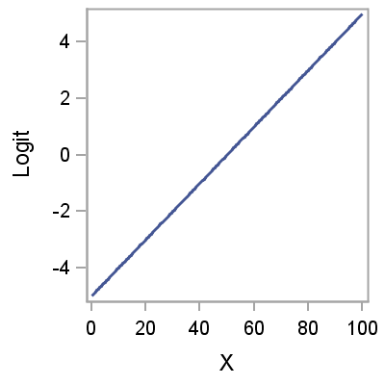
Assumption
Logit
Transformation
Assumption in logistic regression: The logit has a linear relationship with the predictor variables.

Slide 11
Logistic Regression Model
logit(p_{i})=β₀+β₁X_{1i}+…+β_{k}X_{ki}
where
logit (p_{i})= logit of the probability of the event
β₀= intercept of the regression equation
β_{k}= parameter estimate of the k^{th} predictor variable

Slide 12
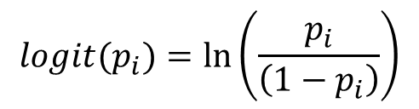
7.04 Multiple Choice Poll
What are the upper and lower bounds for a logit?
  Lower=0, Upper=1
  Lower=0, No upper bound
  No lower bound, No upper bound
  No lower bound, Upper=1
$$logit(p_{i})=ln\left(\frac{p_{i}}{\left(1−p_{i}\right)}\right)$$
Notes:
The answer is c.

Slide 13
7.04 Multiple Choice Poll – Correct Answer
What are the upper and lower bounds for a logit?
  Lower=0, Upper=1
  Lower=0, No upper bound
  No lower bound, No upper bound
  No lower bound, Upper=1
$$logit(p_{i})=ln\left(\frac{p_{i}}{\left(1−p_{i}\right)}\right)$$
Notes:
The answer is c.

Slide 14
LOGISTIC Procedure
General form of the LOGISTIC procedure:
PROC LOGISTIC DATA=SAS-data-set <options>;
CLASS variables </ options>;
MODEL response=predictors </ options>;
UNITS independent1=list ... </ options>;
ODDSRATIO <‘label’> variable </ options>;
OUTPUT OUT=SAS-data-set keyword=name </ options>;
RUN;

Slide 15
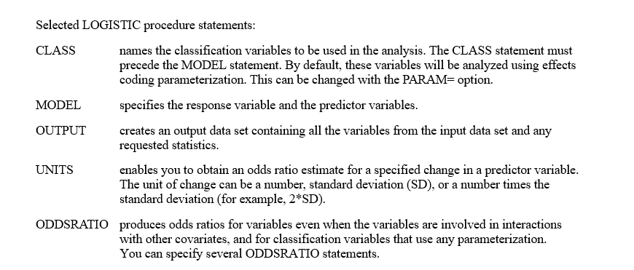
LOGISTIC Procedure

Slide 16
Odds Ratio Calculation from the
Current Logistic Regression Model
The Analysis of Maximum Likelihood Estimates table lists the estimated model parameters, their standard errors, Wald Chi-Square values, and p-values.
Analysis of Maximum Likelihood Estimates
Parameter | DF | Estimate | Standard Error | Wald Chi-Square | Pr > ChiSq
Intercept | 1 | -9.7854 | 1.2896 | 57.5758 | <.0001
Basement_Area | 1 | 0.00739 | 0.00107 | 48.0617 | <.0001
The parameter estimates are the estimated coefficients of the fitted logistic regression model.
The logistic regression equation is logit(
)=−9.7854+(0.00739)*Basement_Area

Slide 17
Odds Ratio Calculation from the
Current Logistic Regression Model
Logistic regression model:
Odds ratio (1 sq. ft. increase in Basement_Area):

Slide 18
Odds Ratio Calculation from the
Current Logistic Regression Model
The odds ratio for a continuous predictor calculates the estimated relative odds for subjects that are one unit apart on the continuous measure. For example, in the Housing Bonus example, Basement_Area is the continuous measure.
The logit is the natural log of the odds. Because you can calculate an estimated logit from the logistic model, the odds can be calculated by simply exponentiating that value.
An odds ratio for a one-unit difference is then the ratio of the exponentiated predicted logits for two people who are one unit apart.
In the example:
The odds ratio for basement_area indicates that the odds of being bonus eligible increase by 0.7% for each increase in 1 square foot of basement area.

Slide 19
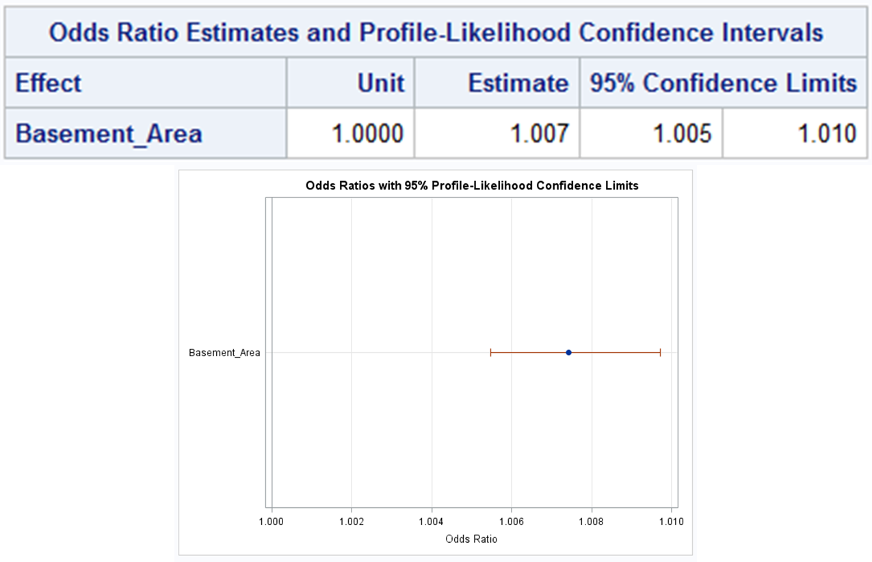
Odds Ratio for a Continuous Predictor
The 95% confidence limits indicate that you are 95% confident that the true odds ratio is between 1.005 and 1.010.
As the 95% confidence interval does not include 1.000, the odds ratio is significant at the 0.05 alpha level.

